Slide 1
CRYPTOCURRENCY PRICE PREDICTION USING LSTM – GRU MODEL
SUPERVISED BY:
Y . GOLD ANAND B.E, M.E
ASSISTANT PROFESSOR / CSE / MNMJEC
PRESENTED BY:
ABDULLAH AMBERKHANI - 311619104002
MOHAMMED ABDUL BASIDH P T - 311619104041
HEMANTH S – 311619104027
IV YEAR CSE A / MNMJEC

Slide 2
ABSTRACT
Cryptocurrency price prediction is a proposed system that utilizes deep learning algorithms (LSTM-GRU) to predict the price of user requested cryptocurrency. The system uses the yfinance library to download cryptocurrency data and pre-processes the data using min-max normalization. The deep learning model used in this program is a combination of GRU and LSTM neural network. The program creates sliding windows to format the data and define hyperparameters such as the learning rate, hidden units, batch size, and epochs. The predicted results are shown on a tkinter-based GUI interface. The program also calculates mean squared error (MSE) and mean absolute percentage error (MAPE) to evaluate the accuracy of the model. The accuracy of this system is close to 95% and overall, it provides accurate results.

Slide 3
INTRODUCTION
Cryptocurrency has become a popular and highly volatile asset class in recent years. As a result, predicting the prices of cryptocurrencies has become a topic of great interest for traders, investors, and researchers alike. This paper proposes a hybrid LSTM-GRU model for cryptocurrency price prediction, which combines the strengths of both models to improve accuracy. The model takes in historical cryptocurrency price data, preprocessed and normalized, and is trained using a sequence-to-sequence learning approach. The proposed model outperforms separate LSTM and GRU models in terms of prediction accuracy, as shown by several performance metrics. This study contributes to the development of reliable cryptocurrency price prediction models, which are essential for traders and investors to make informed investment decisions.

Slide 4
EXISTING SYSTEM
Paid System
People with no programming knowledge cannot use the existing system
Only available for crypto holders
Uses models to predict (ARIMA, SVM, etc )
No open source application available

Slide 5
PROPOSED SYSTEM
Anyone without prior knowledge in coding can use
Uses deep learning model for prediction(LSTM, GRU)
Supports multiple currencies
Desktop application

Slide 6
LITERATURE SURVEY
Issue | Paper | Author | Year | Publish | Technique | Dataset
IEEE | sentiment analysis and emotion detection on cryptocurrency related tweets using ensemble lstm - gru model | Naila Aslam; Furqan Rustam; Ernesto Lee; Patrick Bernard Washington; Imran Ashraf | 2022 | IEEE Access ( volume: 10) | LSTM - GRU MODEL | tweets from twitter
IEEE | Stochastic Neural Networks for Cryptocurrency Price Prediction | Patel Jay; Vasu Kalariya; Pushpendra Parmar; Sudeep Tanwar; Neeraj Kumar; Mamoun Alazab | 2020 | IEEE Access ( Volume: 8) | LSTM – MLP MODEL | Bitcoin, Ethereum, and Litecoin.
IEEE | Deep Learning-Based Cryptocurrency Price Prediction Scheme With Inter-Dependent Relations | Sudeep Tanwar; Nisarg P. Patel; Smit N. Patel; Jil R. Patel; Gulshan Sharma; Innocent E. Davidson | 2021 | IEEE Access ( Volume: 9) | LSTM - GRU MODEL | Litecoin and Zcash
IEEE | Improving the Cryptocurrency Price Prediction Performance Based on Reinforcement Learning | Zeinab Shahbazi; Yung-Cheol Byun | 2021 | IEEE Access ( Volume: 9) | Blockchain framework | Litecoin and Monero
IEEE | DL-GuesS: Deep Learning and Sentiment Analysis-Based Cryptocurrency Price Prediction | Raj Parekh; Nisarg P. Patel; Nihar Thakkar; Rajesh Gupta; Sudeep Tanwar; Gulshan Sharma | 2022 | IEEE Access ( Volume: 10) | Hybrid model which takes sentiment also into account | Bitcoin-Cash, Litecoin , and Bitcoin .

Slide 7
LITERATURE SURVEY
1. Sentiment Analysis And Emotion Detection On Cryptocurrency Related Tweets Using Ensemble LSTM - GRU Model
Authors: Naila Aslam; Furqan Rustam; Ernesto Lee; Patrick Bernard Washington; Imran Ashraf
This paper used a hybrid model (LSTM-GRU) and tweets related to cryptocurrencies from twitter as data and analysed the sentiment it presented and how it would affect the currency
The proposed LSTM-GRU ensemble shows an accuracy of 0.99 for sentiment analysis, and 0.92 for emotion prediction and outperforms both machine learning and state-of-the-art models.

Slide 8
LITERATURE SURVEY
2. Stochastic Neural Networks for Cryptocurrency Price Prediction
Author: Patel Jay; Vasu Kalariya; Pushpendra Parmar; Sudeep Tanwar; Neeraj Kumar; Mamoun Alazab
This paper used the Multi-Layer Perceptron (MLP) and Long Short-Term Memory (LSTM) models for Bitcoin, Ethereum, and Litecoin.
The results show that the proposed model is superior in comparison to the deterministic models.

Slide 9
LITERATURE SURVEY
3. Deep Learning-Based Cryptocurrency Price Prediction Scheme With Inter-Dependent Relations
Author: Sudeep Tanwar; Nisarg P. Patel; Smit N. Patel; Jil R. Patel; Gulshan Sharma; Innocent E. Davidson
This paper used deep-learning-based hybrid model (includes Gated Recurrent Units (GRU) and Long Short Term Memory (LSTM)) to predict the price of Litecoin and Zcash with inter-dependency of the parent coin.
Results illustrate that the proposed model forecasts the prices with high accuracy compared to existing models.

Slide 10
LITERATURE SURVEY
4. Improving the Cryptocurrency Price Prediction Performance Based on Reinforcement Learning
Author: Zeinab Shahbazi; Yung-Cheol Byun
This paper used blockchain framework for secure transaction environment and Reinforcement Learning algorithm for analysis and prediction of price. The main focus of this system is on Litecoin and Monero cryptocurrencies.
The results show the presented system accurate the performance of price prediction higher than another state-of-art algorithm.

Slide 11
LITERATURE SURVEY
5. Improving the Cryptocurrency Price Prediction Performance Based on Reinforcement Learning
Author: Raj Parekh; Nisarg P. Patel; Nihar Thakkar; Rajesh Gupta; Sudeep Tanwar; Gulshan Sharma
This paper uses hybrid and robust framework, DL-Guess , for cryptocurrency price prediction, that considers its interdependency on other cryptocurrencies and also on market sentiments. It considered price prediction of Dash carried out using price history and tweets of Dash , Litecoin , and Bitcoin for various loss functions for validation.
It shows The results for price prediction of Bitcoin-Cash with the price history and tweets of Bitcoin-Cash , Litecoin , and Bitcoin .

Slide 12
REQUIREMENTS
HARDWARE
Processor : Any Intel Processor
GPU : 4GB or more
Hard Disk : 10GB or more
Speed : 1.4GHZ or more
SOFTWARE
This Python desktop application is platform-agnostic and can be executed on any operating system.

Slide 13
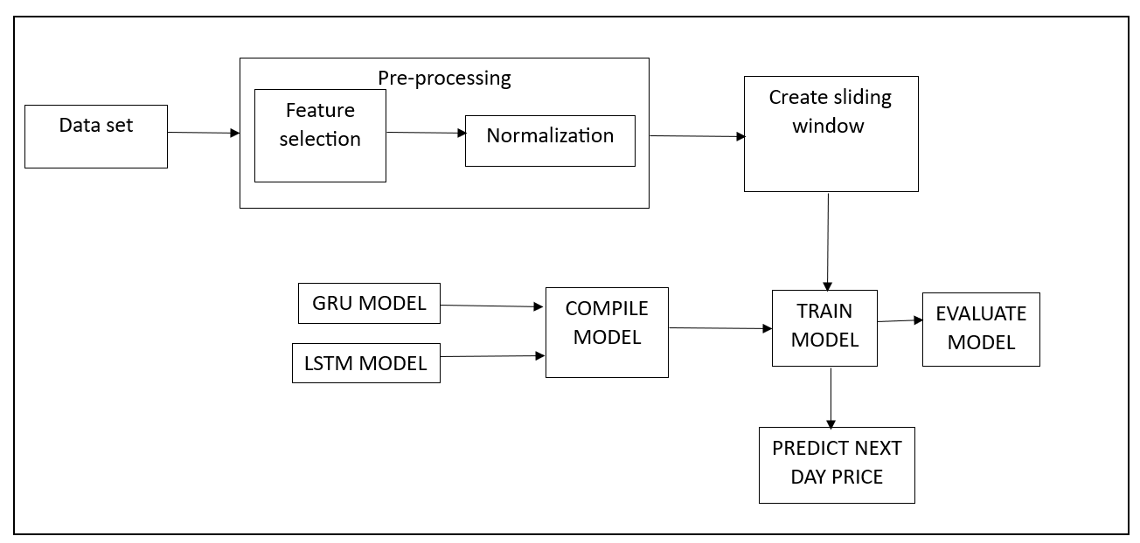
ARCHITECTURE DIAGRAM

Slide 14
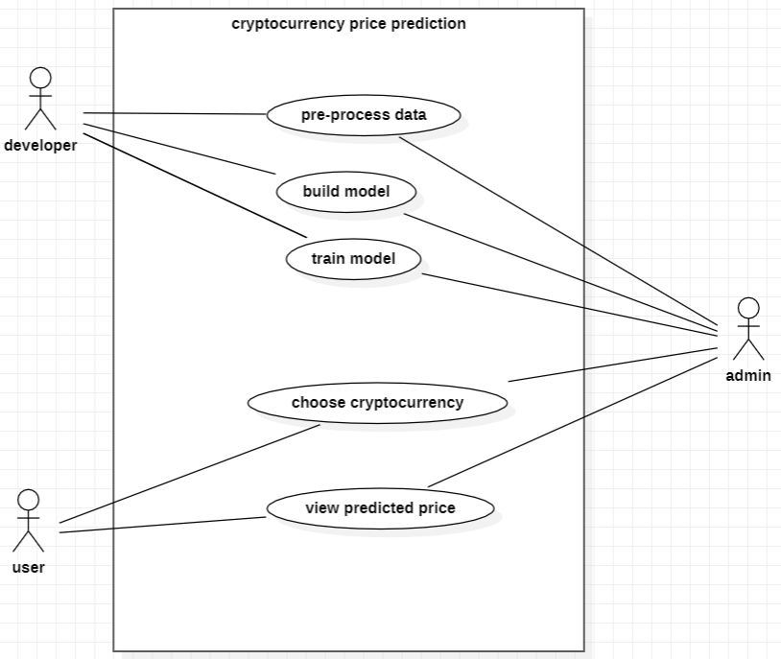
USECASE DIAGRAM

Slide 15
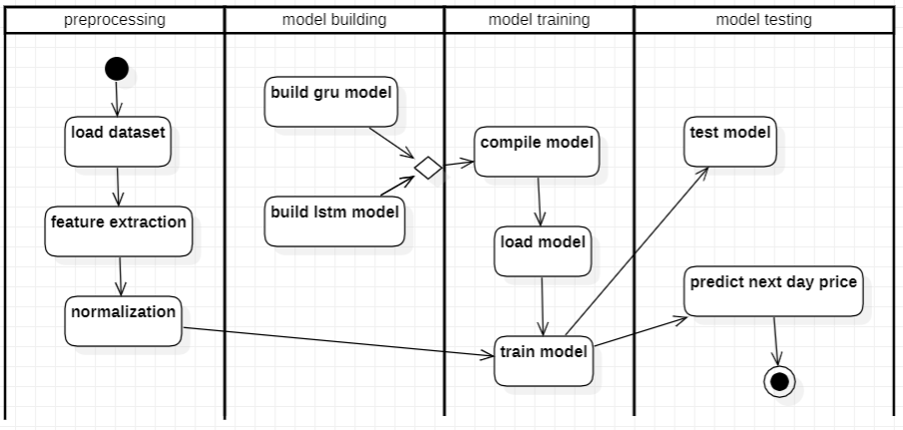
ACTIVITY DIAGRAM

Slide 16
MODULES
DATASET COLLECTION
PREPROCESSING OF DATA
PREDICTION ALGORITHM(LSTM-GRU)
EVALUATE ACCURACY

Slide 17
MODULE 1 – DATA COLLECTION
The first step is to collect historical price data for the cryptocurrency you want to predict. We used yahoo finance(yfinance) that provide historical price data for cryptocurrencies.

Slide 18
MODULE 2- PREPROCESSING
The next step is to pre-process the data to make it suitable for LSTM and GRU model. A feature is selected. The feature is normalized using Min-Max normalization. The normalized dataset is then partitioned into training, validation, and test sets. A sliding window technique is applied to the partitioned data sets to create input/output pairs for the machine learning model.

Slide 19
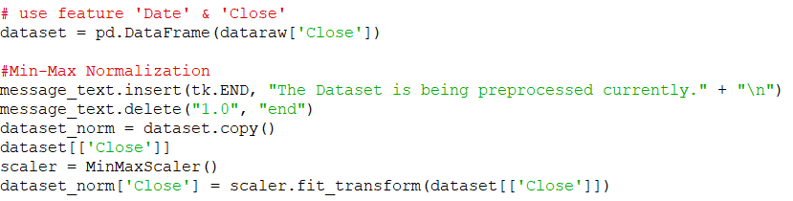
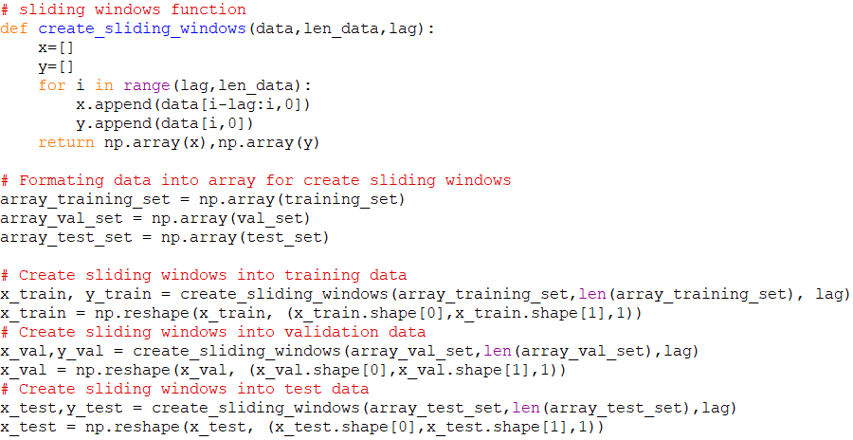
MODULE 2- PREPROCESSING

Slide 20
MODULE 3 – PREDICTION ALGORITHM
This phase involves creates and trains deep learning models, specifically GRU and LSTM. First, hyperparameters such as learning rate, batch size, and epochs are defined. Using the Keras library, the GRU and LSTM models are defined with dropout and an output layer with one unit. Both models are compiled with the Adam optimizer and mean squared error as the loss function. They are trained on the training data using the fit() method with the defined hyperparameters and sliding windows data. The trained models are evaluated on the test data using the evaluate() method with mean squared error and mean absolute percentage error as the metrics. Finally, the trained models are used to make predictions on future data using the predict() method.

Slide 21
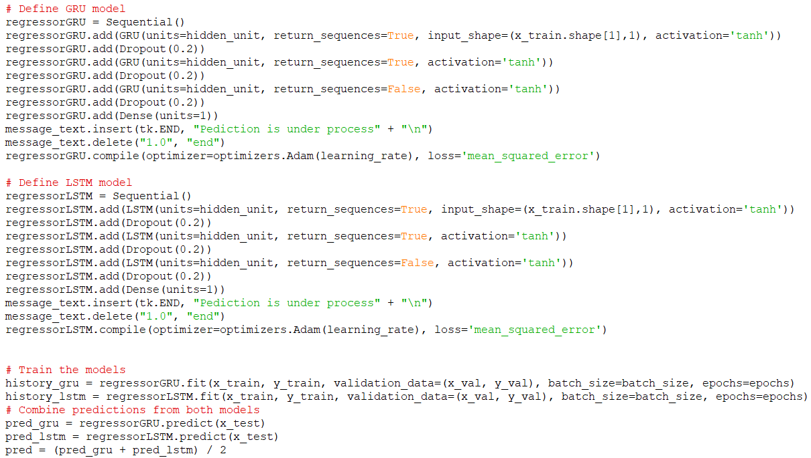
MODULE 3 – PREDICTION ALGORITHM

Slide 22
MODULE 4 – EVALUATING ACCURACY
After training the LSTM-GRU model, the next step is to evaluate its performance. This involves comparing the predicted prices with the actual prices to measure the accuracy of the model. Also the model is compared with GRU and LSTM separately.

Slide 23
RESULT AND ANALYSIS
To assess the precision of the model, we can compare its predicted values against the actual values. The model was trained on 70% of the available historical data, validation set containing 10% and the remaining 20% was used for testing. The loss function being used by the model is mean squared error, with the Adam optimizer employed to minimize the loss. To measure the accuracy of the model, various metrics such as mean absolute percentage error (MAPE) and root mean squared error (RMSE) can be utilized by comparing the predicted values against the actual values. Additionally, a line chart can be used to visually compare the predicted and actual values. The (MAPE) of most cryptocurrencies is observed to be around 5%.

Slide 24
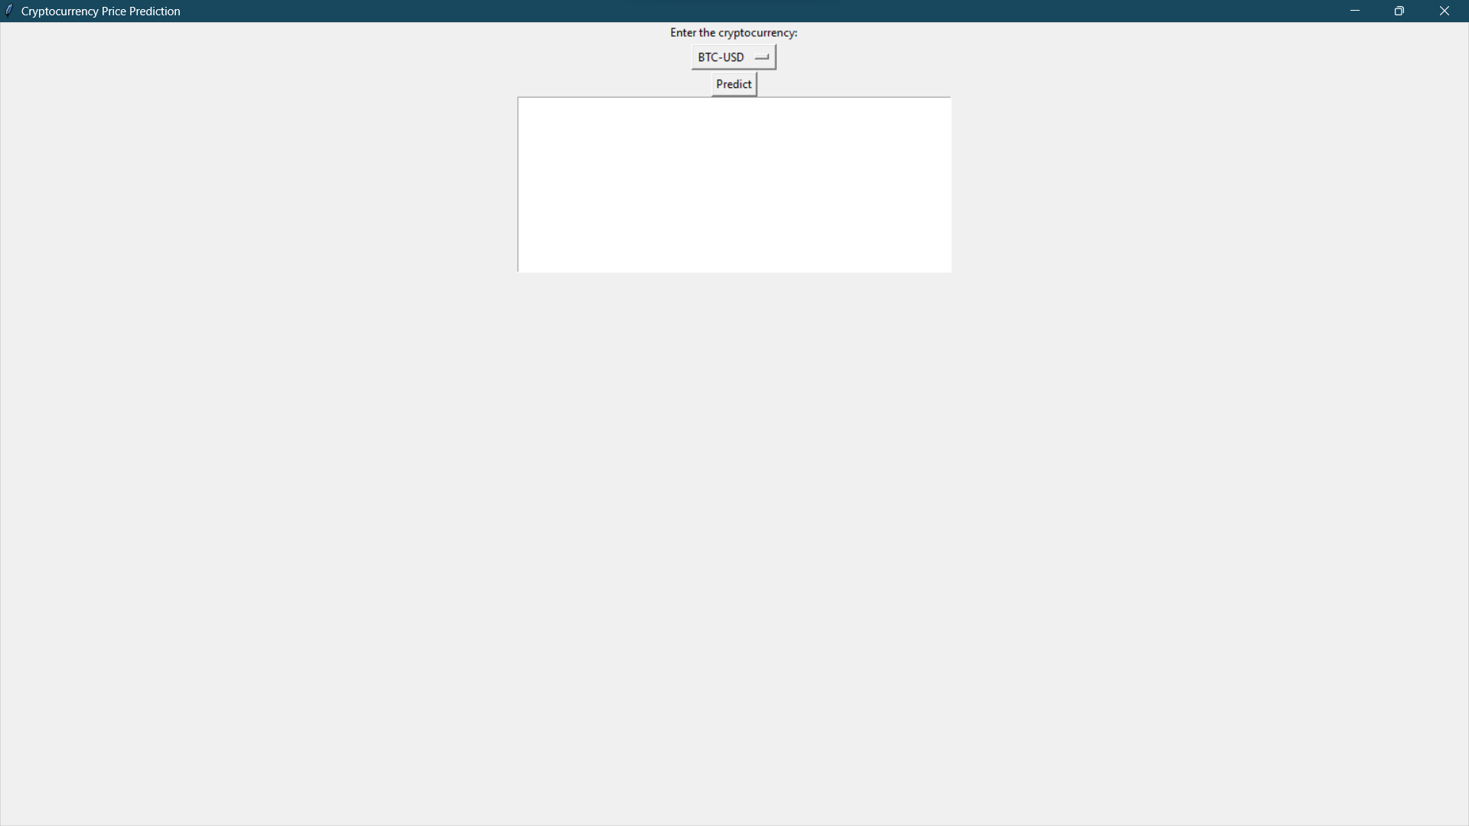
SCREENSHOTS

Slide 25
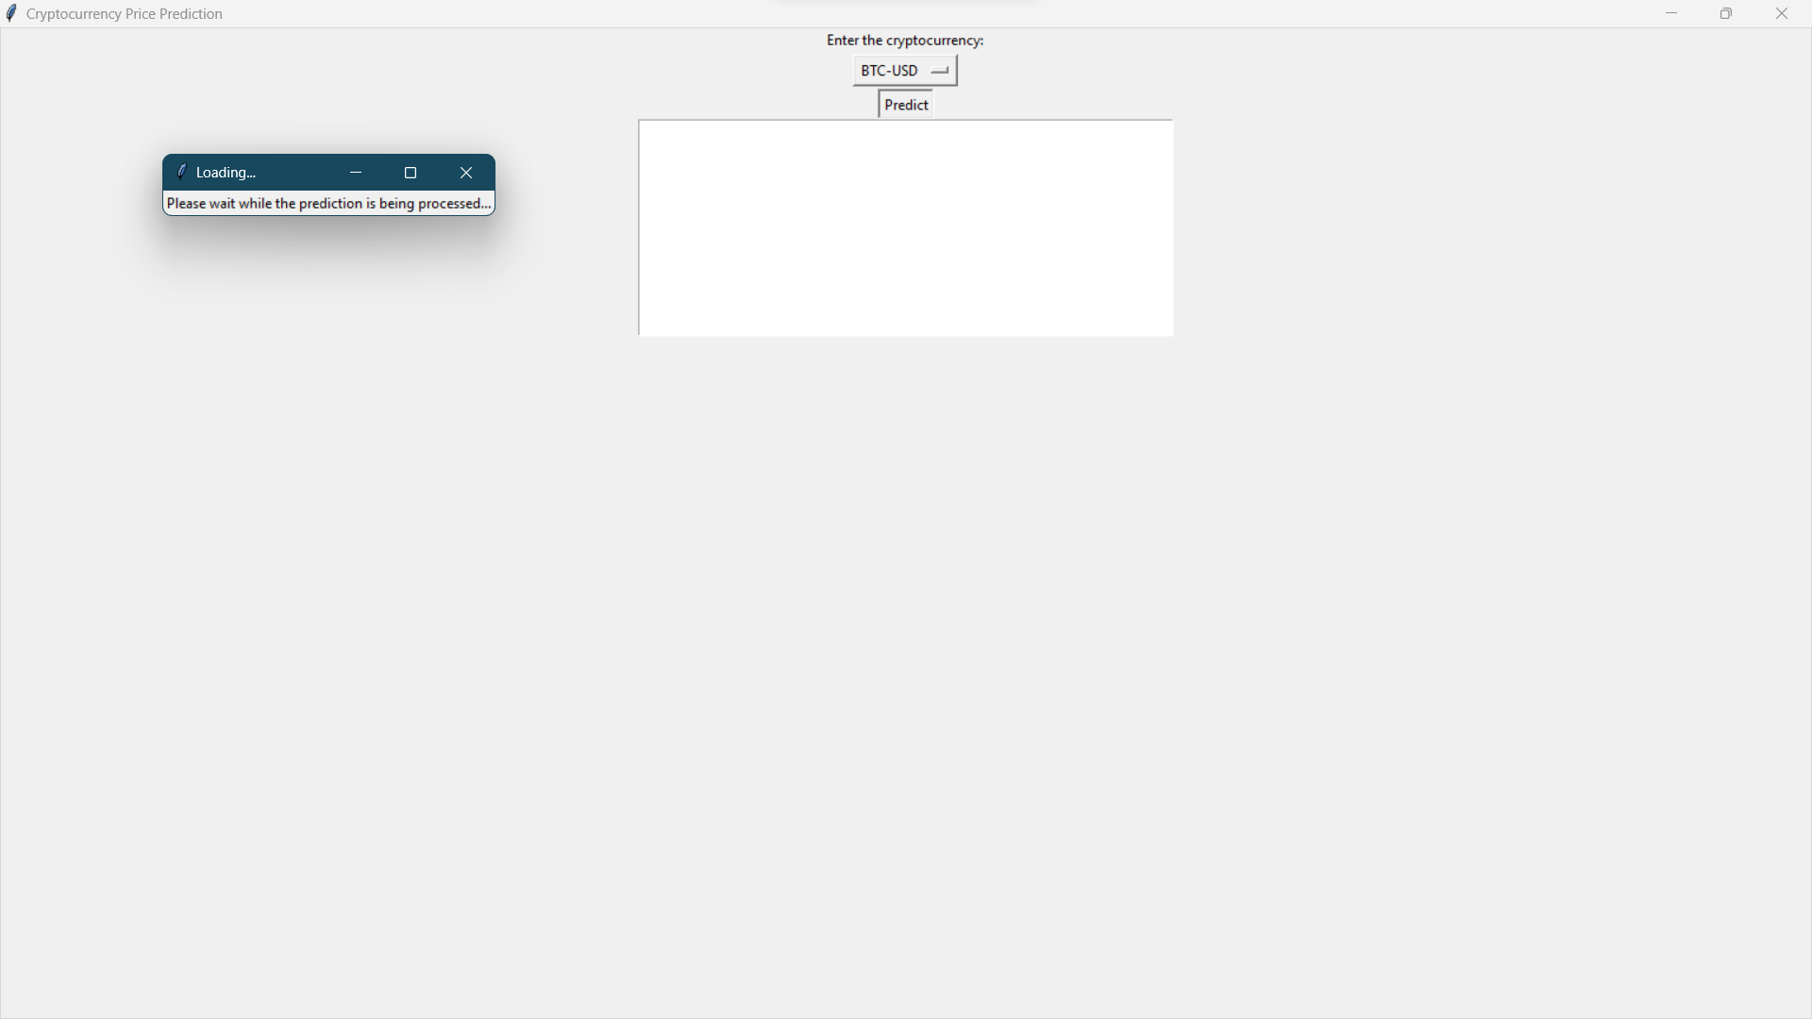
SCREENSHOTS

Slide 26
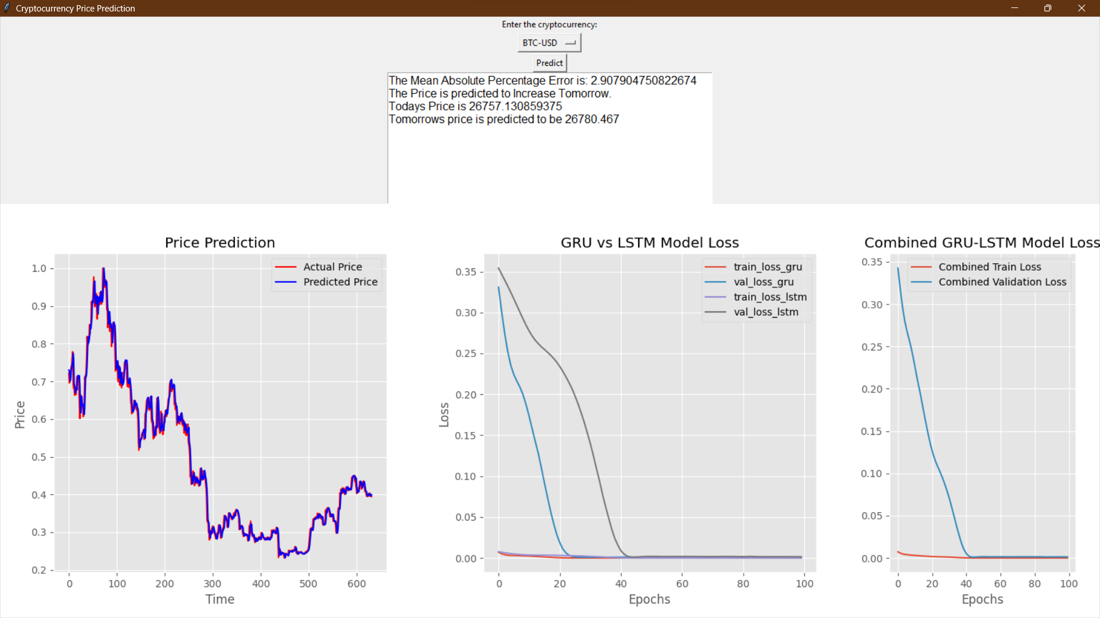
SCREENSHOTS

Slide 27
CONCLUSION AND FUTURE ENHANCEMENT
The code is a functional implementation of a LSTM-GRU model to predict the price of a cryptocurrency based on its historical data using the yfinance library. The user selects the cryptocurrency for which they want to predict the price, and the code returns a prediction for the next day's price along with a graph of the actual and predicted prices.
Here are some suggestions for future enhancements:
Add error handling to deal with incorrect user inputs, such as invalid cryptocurrency names or network errors when downloading data from Yahoo Finance.
Improve the accuracy of the prediction model. One way to do this is to experiment with different hyperparameters and models to see which one performs the best on the given dataset.
Add more features to the prediction model, such as volume and open price, to see if they improve the accuracy of the model.
Add a save function to save the predicted prices and graphs to a file. This can be useful for keeping a record of the predicted prices over time.

Slide 28
THANK YOU

